Slide 1

Book Mood recommendation
Morenkeji Olowo David -11362​

Slide 2

About THIS PROJECT
This project is a React Based Project that utilizes key react concepts and hooks to develop an effective system. With this, we can easily find books tailored to your current mood.

Slide 3

How It Works
Step 1
Step 2
Step 3
User selects their Mood
User chooses the book they want to read
Two buttons to buy on amazon or read more on google
….
3 EASY STEPS

Slide 4
KEY-CONCEPTS
useNavigate
useParams
Enables user to navigate to different routes
Allows users grab dynamic items from the URL
useEffect
mapping
Allows the system carry out Side effect functions while the page is rendered

Slide 5

benefits
* Tailored Books according to mood
*Easy Navigation
*Buying online wouldn’t be difficult​

Slide 6
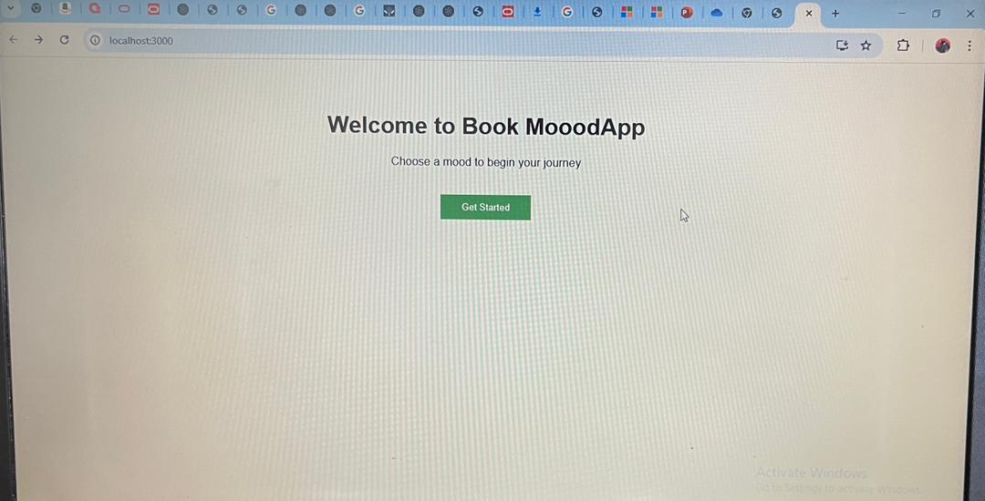


Slide 7
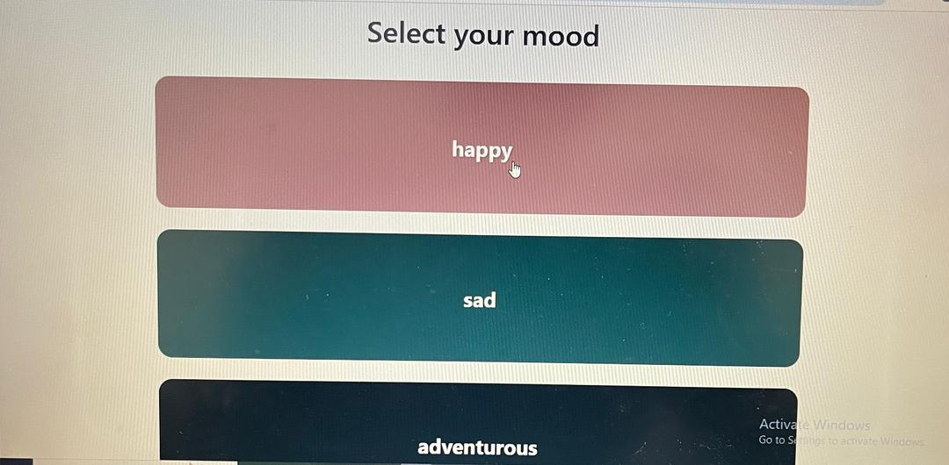

Slide 8
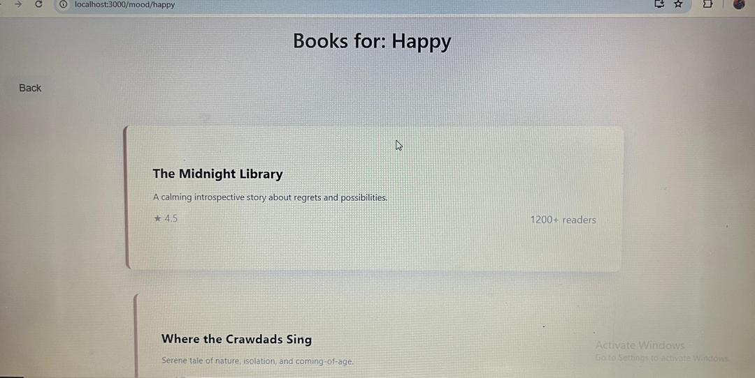

Slide 9
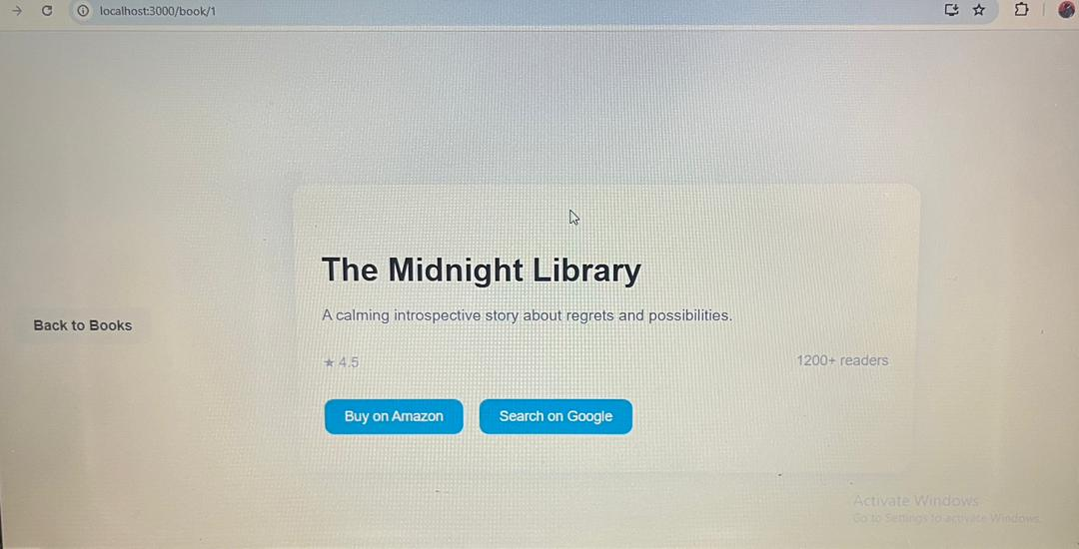

Slide 10

Future improvements
Utilizing databses
Allow users add books (Creator Tools)
Better UI with styling & animations.

Slide 11

Thank you
Olowo Morenikeji David​​
VUG-SEN-24-11362​

